Slide 1

Chapter 4.3
Loss System with Finite Number of Sources: Engset Model
Performance Evaluation of the Internet of Things (IoT)
Module Course: Performance Evaluation of Distributed Systems
Prof. Tobias Hoßfeld, Summer Semester 2022

Slide 2
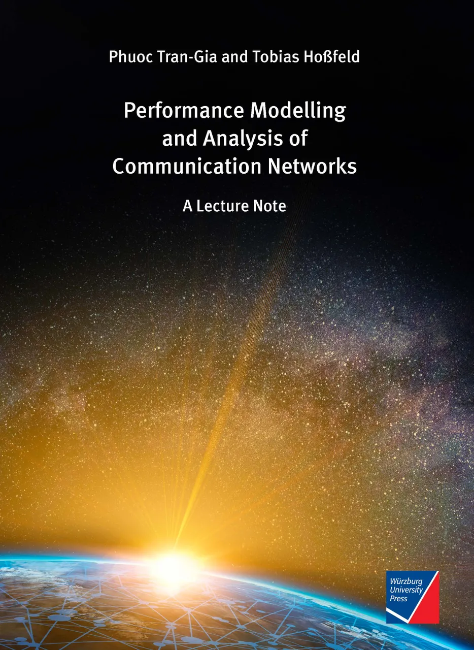
Disclaimer and Copyright Notice
Lecture slides, figures, and scripts are based on the open access text book “Performance Modeling and Analysis of Communication Networks”. The book and scripts are licensed under the Creative Commons License Attribution-ShareAlike 4.0 International (CC BY-SA 4.0). If you remix, transform, or build upon the material, you must distribute your contributions under the same license as the original.
The book must be cited and the disclaimer attached when using lectures slides or scripts.
Tran-Gia, P. & Hossfeld, T. (2021). Performance Modeling and Analysis of Communication Networks - A Lecture Note. Würzburg University Press. https://doi.org/10.25972/WUP-978-3-95826-153-2
Website to download book, exercises, slides and scripts: https://modeling.systems/

Slide 3
Chapter 4
4 Analysis of Markovian Systems
4.1 Loss System M/M/n
4.1.1 Model Structure and Parameters
4.1.2 State Process and State Probabilities
4.1.3 Other System Characteristics
4.1.4 Generalization to Loss System M/GI/n
4.1.5 Modeling Examples and Applications
4.2 Delay System M/M/n
4.2.1 Model Structure and Parameters
4.2.2 State Process and State Probabilities
4.2.3 Other System Characteristics
4.2.4 Delay Distribution
4.2.5 Example: Single Server Delay System
4.3 Loss System with Finite Number of Sources
4.3.1 Model Structure and Parameters
4.3.2 State Process and State Probabilities
4.3.3 Example: Mobile Cell with Finite Number of Sources
4.4 Customer Retrial Model with Finite Number of Sources
4.4.1 Model Structure and Parameters
4.4.2 Recursive Analysis Algorithm
4.4.3 Calculation of Traffic Flows
4.4.4 Example: Mobile Cell with Customer Retrials
4.5 Processor Sharing Model M/M/1-PS

Slide 4
Poisson Process: Infinite Number of Sources
Lecture

Slide 5
Model Structure and Parameters

Slide 6
Engset Model: Finite Number of Traffic Sources

Slide 7
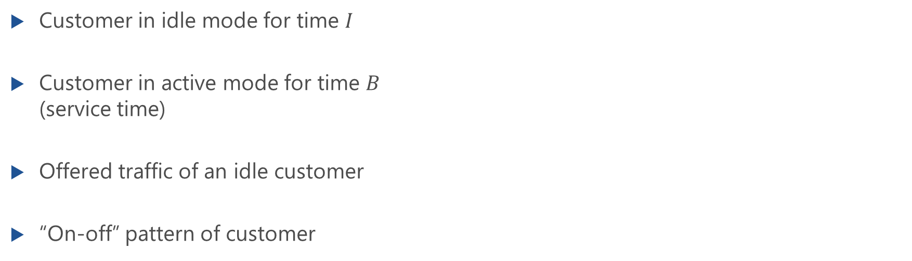
Model of Customer Behavior
Customer in idle mode for time $I$
Customer in active mode for time $B$ (service time)
Offered traffic of an idle customer
“On-off” pattern of customer

Slide 8
State Process and State Probabilities

Slide 9
State Transition Diagram: Derivation
Lecture

Slide 10

State Transition Diagram
Birth-and-death process
State probabilities follow from BD processes (Ch. 3)
for $i=0,1,2,…,n$ and $m>n$

Slide 11
State Probabilities: Derivation
Lecture

Slide 12
State Probabilities: Derivation (f.)
Lecture

Slide 13
Blocking Probability
Arrival theorem, random observer property

Slide 14
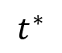
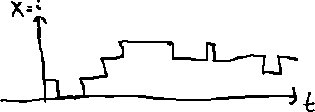
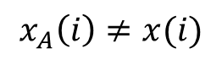
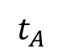
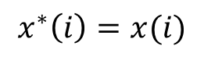
State Probabilities at Arbitrary Time and Arrival Time
At arbitrary time
At arrival times
PASTA propery not valid
state-dependent arrival rates
Blocking probability
at arrival time
$$x^{∗}\left(i\right)=x(i)$$
$$x_{A}\left(i\right)≠x(i)$$
$$t^{∗}$$
$$t_{A}$$

Slide 15
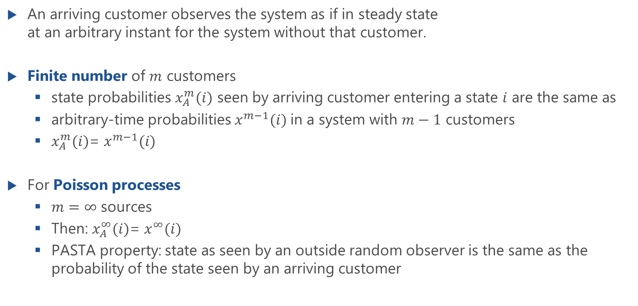
Arrival Theorem: Random Observer Property
An arriving customer observes the system as if in steady state at an arbitrary instant for the system without that customer.
Finite number of $m$ customers
state probabilities $x_{A}^{m}(i)$ seen by arriving customer entering a state $i$ are the same as
arbitrary-time probabilities $x^{m−1}(i)$in a system with $m−1$ customers
$x_{A}^{m}(i)$= $x^{m−1}(i)$
For Poisson processes
$m=∞$ sources
Then: $x_{A}^{∞}(i)$= $x^{∞}(i)$
PASTA property: state as seen by an outside random observer is the same as the probability of the state seen by an arriving customer

Slide 16
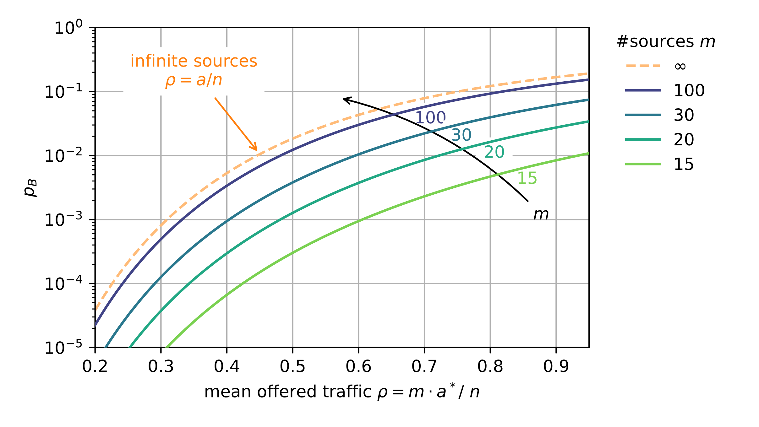
Blocking Probability
State probability at arbitrary time
State probability at arrival time
Blocking probability: Engset formula

Slide 17
Example: Mobile Cell
with finite number of sources

Slide 18

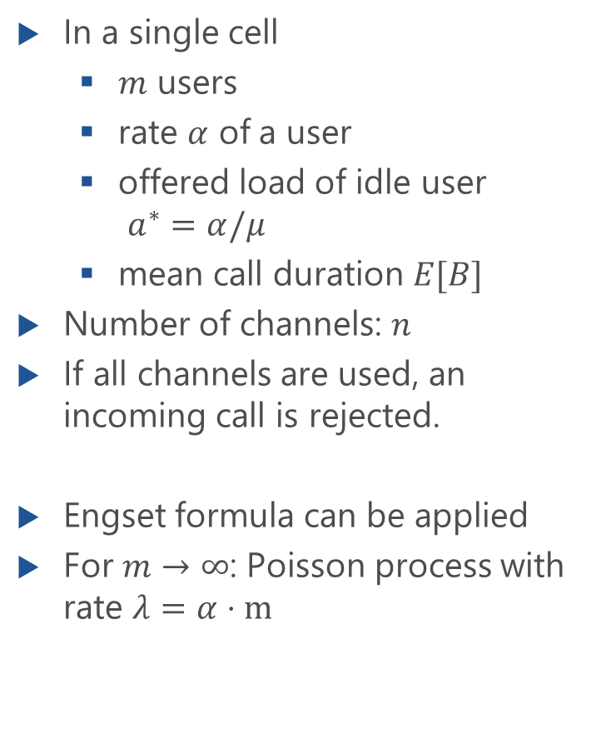
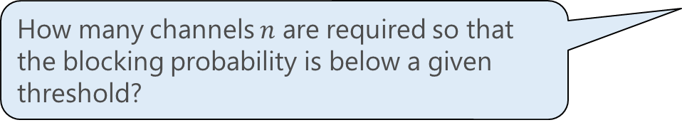
Example: Mobile Cell
In a single cell
$m$ users
rate $α$ of a user
offered load of idle user $a^{∗}=α/μ$
mean call duration $E[B]$
Number of channels: $n$
If all channels are used, an incoming call is rejected.
Engset formula can be applied
For $m→∞$: Poisson process with rate $λ=α⋅m$
How many channels $n$ are required so that the blocking probability is below a given threshold?

Slide 19
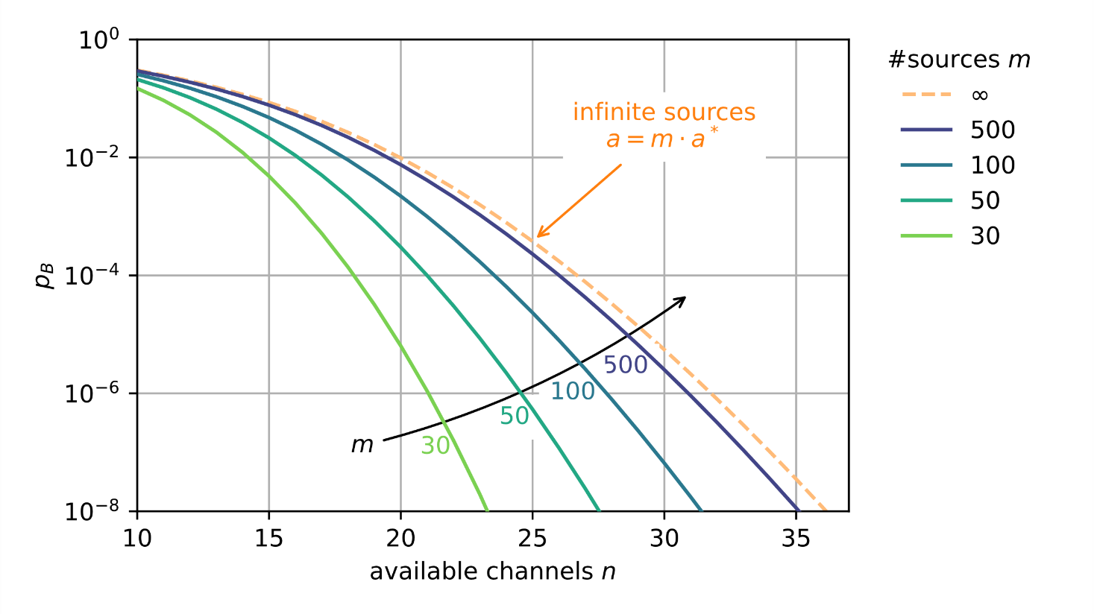
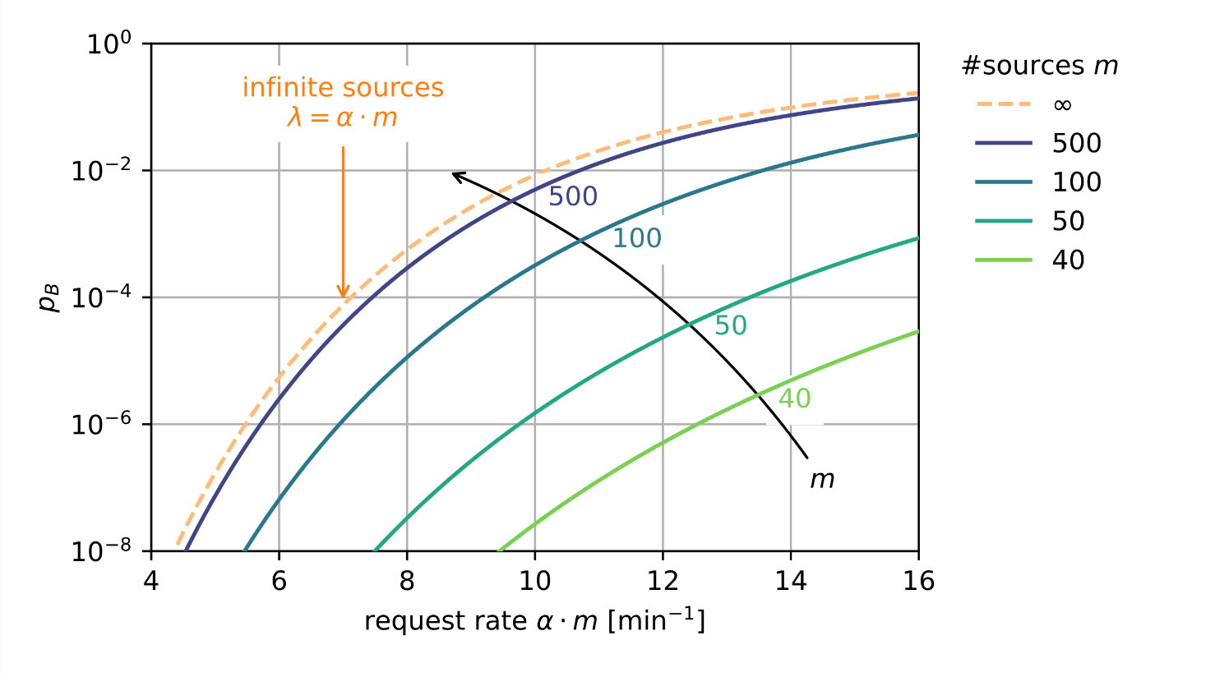
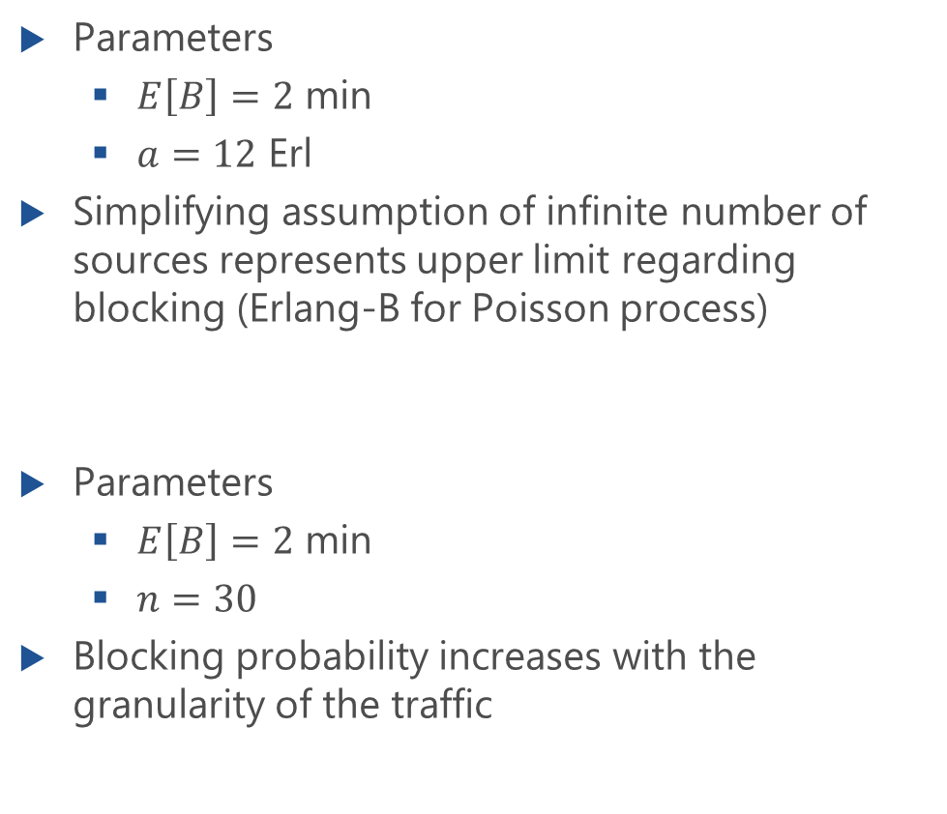
Blocking Probability
Parameters
$E\left[B\right]=2$ min
$a=12$ Erl
Simplifying assumption of infinite number of sources represents upper limit regarding blocking (Erlang-B for Poisson process)
Parameters
$E\left[B\right]=2$ min
$n=30$
Blocking probability increases with the granularity of the traffic

